Slide 1
How to create and run a runnable jar file in VS Code + Maven
CSC 4760 / 6760 Big Data Programming
Spring 2020

Slide 2
How to run a “.jar” file in Linux
In Eclipse, we create a project “HelloWorld”, add “HelloWorld.java” file
Export the “HelloWorld.jar” file, which is a runnable jar file.
Open the terminal, and run the command:
“HelloWorld.java” file
java -jar HelloWorld.jar
package HelloWorld;
public class HelloWorld {
public static void main(String[] args) {
// Prints "Hello, World" to the terminal
System.out.println("Hello, World");
}
}
You will see “Hello World!”

Slide 3
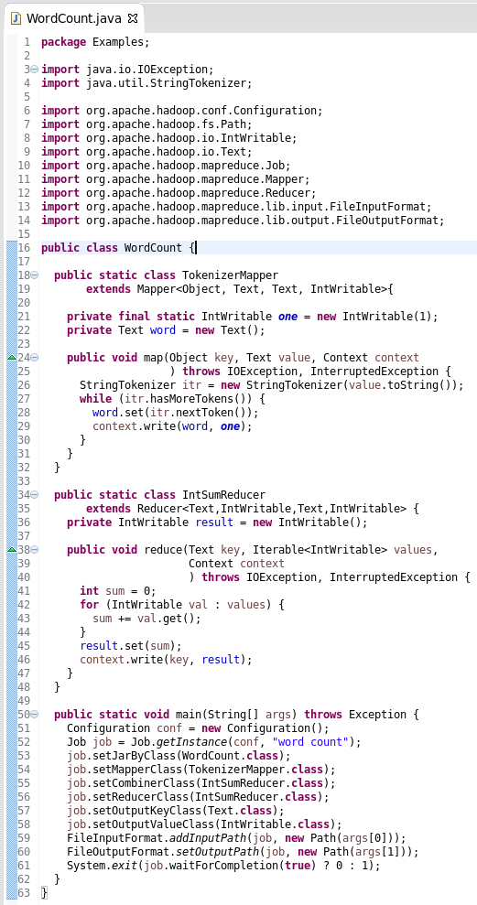
MapReduce Code: WordCount
https://hadoop.apache.org/docs/stable/hadoop-mapreduce-client/hadoop-mapreduce-client-core/MapReduceTutorial.html

Slide 4
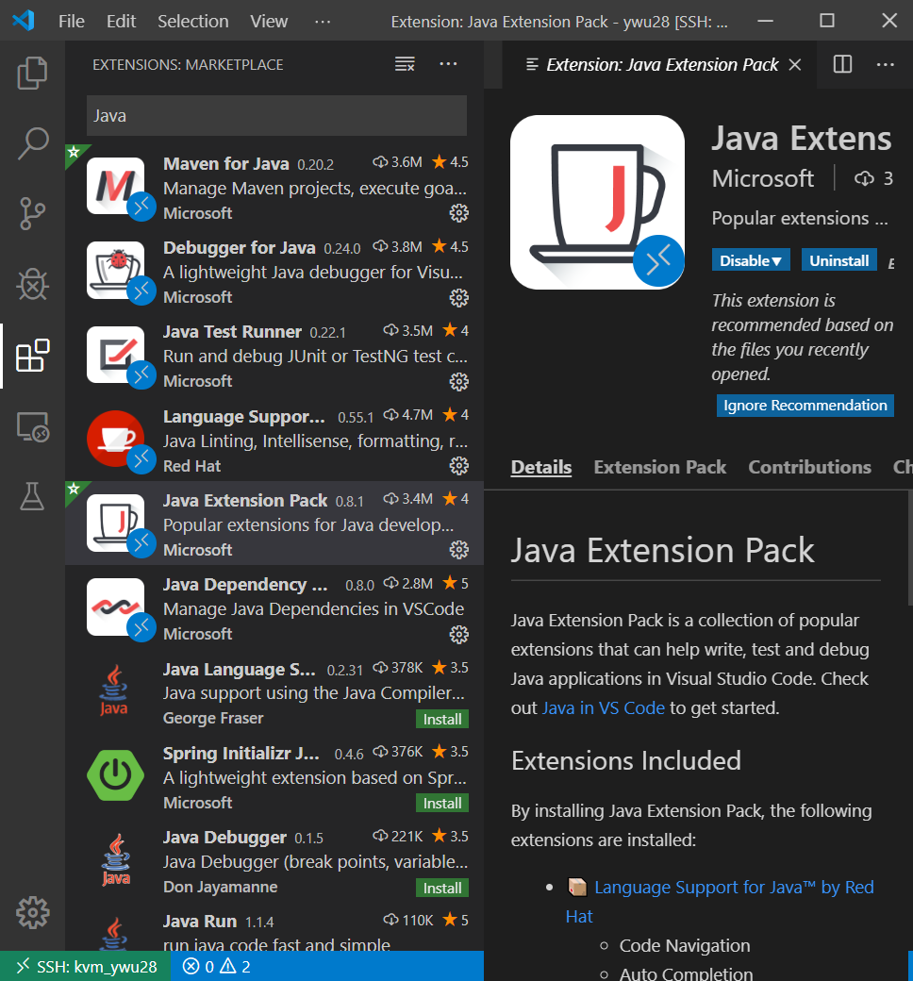
VS Code - Java Extension Pack
Java Extension Pack includes:
Debugger for Java
Java Test Runner
Maven for Java
Java Dependency Viewer
Visual Studio IntelliCode
Language Support for Java by RedHat

Slide 5
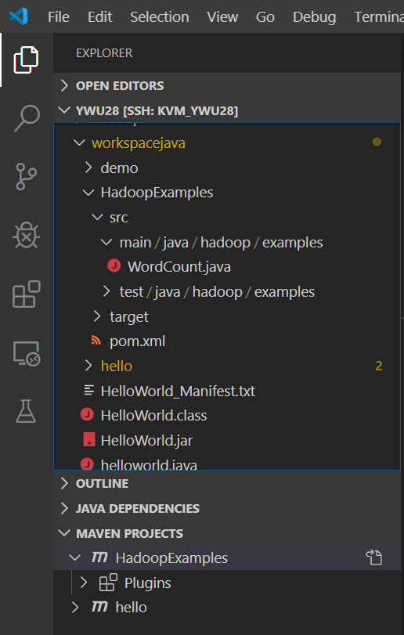
VS Code - Create a new Maven project
VS Code => Explorer => Maven Projects => “+” (Create Maven Project) => maven-archetype-quickstart
Version 1.4
Folder: /home/CampusID/workspacejava/
Answer some questions:
groupId: # something like edu.gsu
artifactId: # Project name “HadoopExamples”
version: # 1.0
package: # hadoop.examples

Slide 6
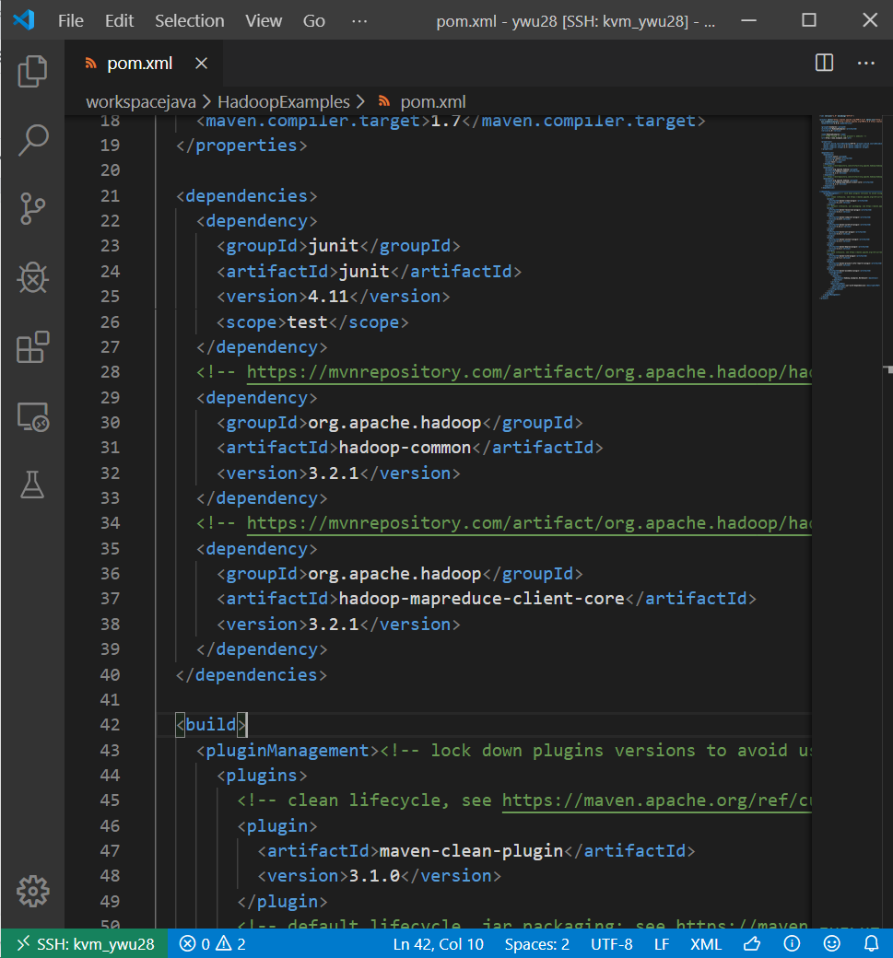
pom.xml - dependency
Hadoop dependency:
Apache Hadoop Common 3.2.1
Apache Hadoop MapReduce Core 3.2.1

Slide 7
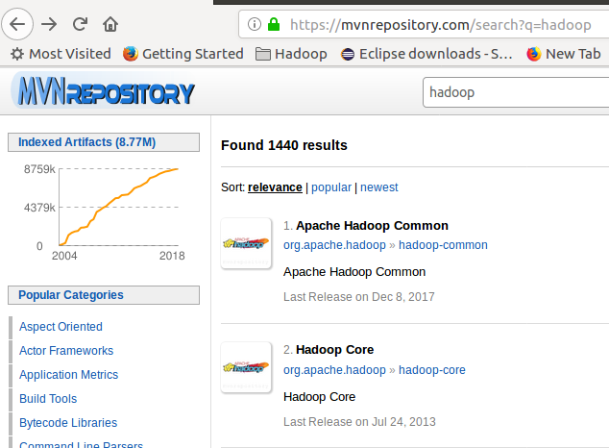
Add Hadoop lib to Maven
Google “maven repository”
Click on the first link: https://mvnrepository.com
Search “hadoop”

Slide 8
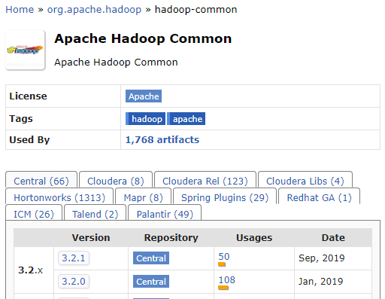
Add Hadoop lib to Maven
Google “maven repository”
Click on the first link: https://mvnrepository.com
Search “hadoop”
Click “Apache Hadoop Common” => 3.2.1
Copy the “dependency” code for Maven, and paste it in pom.xml

Slide 9
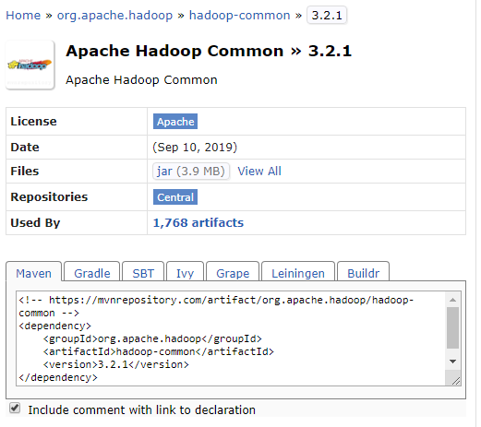
Add Hadoop lib to Maven
Google “maven repository”
Click on the first link: https://mvnrepository.com
Search “hadoop”
Click “Apache Hadoop Common” => 3.2.1
Copy the “dependency” code for Maven, and paste it in pom.xml

Slide 10
Apache Hadoop Common
<!-- https://mvnrepository.com/artifact/org.apache.hadoop/hadoop-common -->
<dependency>
<groupId>org.apache.hadoop</groupId>
<artifactId>hadoop-common</artifactId>
<version>3.2.1</version>
</dependency>

Slide 11
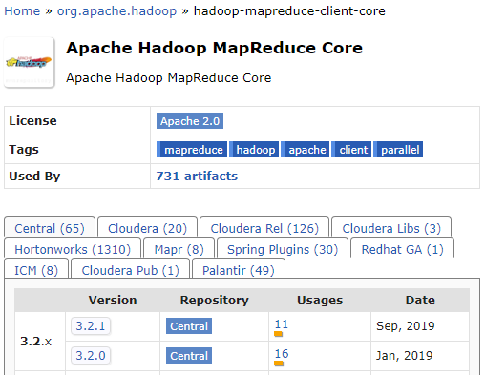
Add Hadoop lib to Maven
Google “maven repository”
Click on the first link: https://mvnrepository.com
Search “hadoop”
Click “Apache Hadoop MapReduce Core” => 3.2.1
Copy the “dependency” code for Maven, and paste it in pom.xml

Slide 12
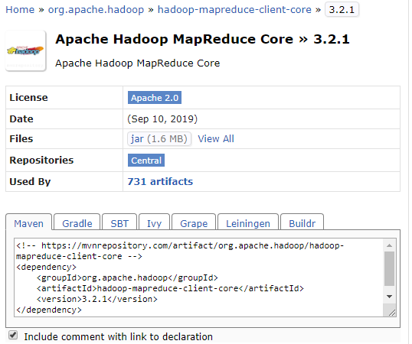
Add Hadoop lib to Maven
Google “maven repository”
Click on the first link: https://mvnrepository.com
Search “hadoop”
Click “Apache Hadoop MapReduce Core” => 3.2.1
Copy the “dependency” code for Maven, and paste it in pom.xml

Slide 13
Apache Hadoop MapReduce Core
<!-- https://mvnrepository.com/artifact/org.apache.hadoop/hadoop-mapreduce-client-core -->
<dependency>
<groupId>org.apache.hadoop</groupId>
<artifactId>hadoop-mapreduce-client-core</artifactId>
<version>3.2.1</version>
</dependency>

Slide 14
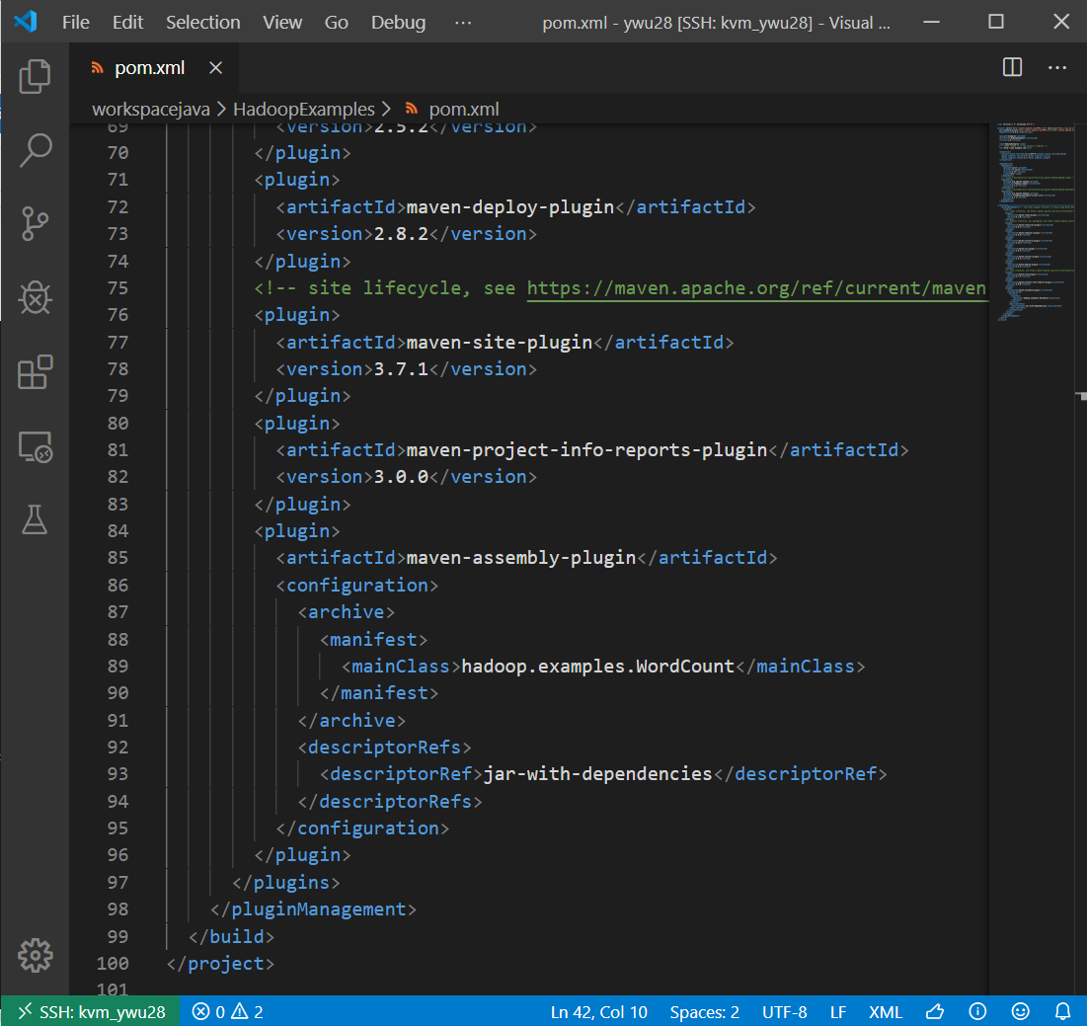
pom.xml - maven-assembly-plugin
maven-assembly-plugin will help generate runnable .jar file
How to create runnable JAR file with Maven
https://javavids.com/video/how-to-create-runnable-jar-file-with-maven
How to Create an Executable JAR with Maven
https://www.baeldung.com/executable-jar-with-maven

Slide 15
<plugin>
<artifactId>maven-assembly-plugin</artifactId>
<configuration>
<archive>
<manifest>
<mainClass>hadoop.examples.WordCount</mainClass>
</manifest>
</archive>
<descriptorRefs>
<descriptorRef>jar-with-dependencies</descriptorRef>
</descriptorRefs>
</configuration>
</plugin>

Slide 16
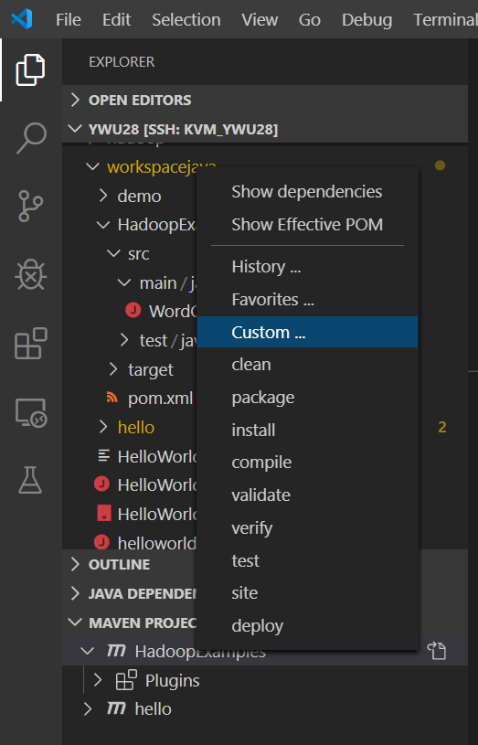
Maven - build the project
Right click on the maven project
Choose “Custom …”
Input: “clean package assembly:single”
The generated .jar file will be in the “/target” folder
Next time, you can choose “History …”

Slide 17
Run the jar file - Using local file system
Command to run a “.jar” file
hadoop jar WordCount.jar file:///home/ywu28/data/peterpan.txt file:///home/ywu28/output
Runnable JAR file
Input file
Output Directory
Note:
file:///home/ywu28/output folder must not exist; a new folder; otherwise errors appear

Slide 18
If you donot specify the “Main Class” in “Run Configuration”, you need to specify it in the “hadoop” command
Command to run a “.jar” file
Name of main class “WordCount”
hadoop jar WordCount.jar /user/rob/data/peterpan.txt /user/rob/output
Runnable JAR file
Input file
Output Directory
Try:
hadoop jar WordCount.jar WordCount /user/rob/data/peterpan.txt /user/rob/output
hadoop jar WordCount.jar WordCount.WordCount /user/rob/data/peterpan.txt /user/rob/output

Slide 19
Trick in Running Hadoop command
Good Command:
hadoop jar WordCount.jar /user/rob/data/peterpan.txt /user/rob/output
Good Command:
hadoop jar WordCount.jar /user/rob/data/ /user/rob/output
Read and process all the files in the directory “/user/rob/data/”
Bad Command:
hadoop jar WordCount.jar /user/rob/data/ /user/rob/data/output
Hadoop will create a folder “/user/rob/data/output”. It is not a file. It is a folder.
You will get an error.

Slide 20
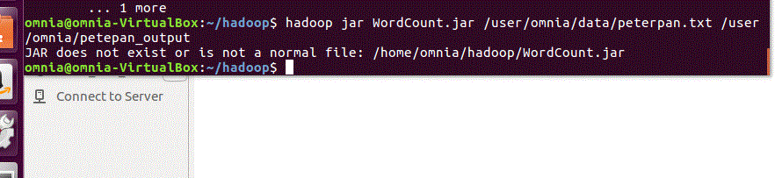
Example of Bad Commands
Need to specify the exact directory of WordCount.jar
hadoop jar /home/omnia/Test/WordCount.jar /user/omnia/data/ /user/omnia/data/output

